Slide 1
More problems on Ch1

Slide 2
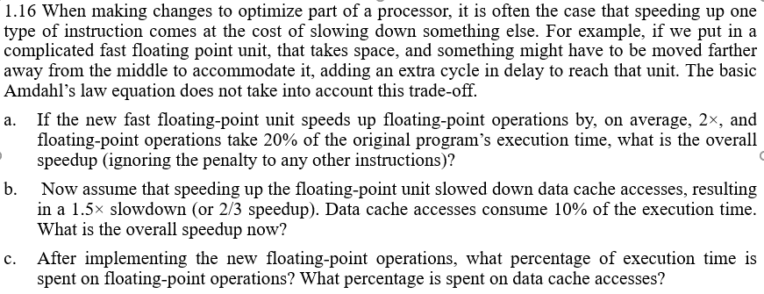
Problem 1

Slide 3

Solution

Slide 4
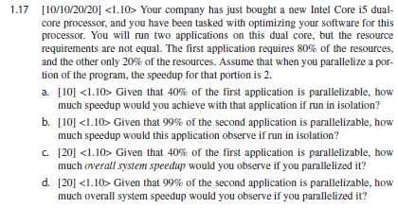
Problem 2

Slide 5
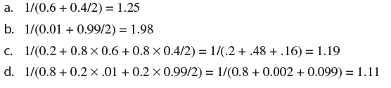
Solution

Slide 6
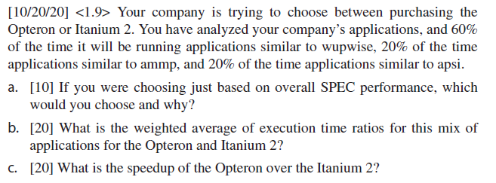
Problem 3

Slide 7

Solution

Slide 8
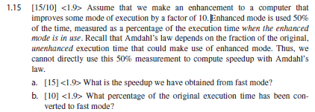
Problem 4

Slide 9
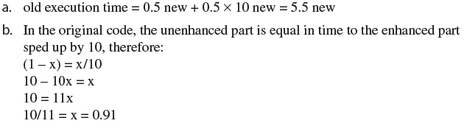
Solution

